Slide 1
Recipe Review Sentiment Classification Using Classical NLP and Machine Learning
An End-to-End NLP & Machine Learning Project
Venus Zayoud

Slide 2
PROJECT OVERVIEW
🎯 BUSINESS PROBLEM
Understanding user sentiment in recipe reviews
to improve recommendations & user experience
⚙️ TECHNICAL OBJECTIVES
• Build NLP preprocessing pipeline
• Compare vectorization methods (Count vs TF-IDF)
• Train ML models (LR, NB, Linear SVC)
• Handle class imbalance with SMOTE
🔑 SKILLS DEMONSTRATED
Text preprocessing | Model selection
Imbalanced data handling | Multi-class sentiment

Slide 3
ABOUT THE DATASET
📂 SOURCE: UCI Machine Learning Repository
📊 18,000+ recipe reviews
FEATURES:
• Review text • Star ratings (1-5)
• User reputation • Engagement metrics
• Recipe info • Timestamps
📊 KEY INSIGHTS:
• Avg review length: 204 characters
• Reviews generally short and informal

Slide 4
DATA PREPARATION & EXPLORATION
DATA QUALITY ASSESSMENT
✅ Missing values: Only 2 (0.01%) - filled with “ “
✅ Duplicates: None found
✅ Removed: 'Unnamed: 0' index column
FEATURE ENGINEERING
📅 Temporal: year, month, day_of_week
📏 Review length: avg 204 chars, median 161 chars

Slide 5
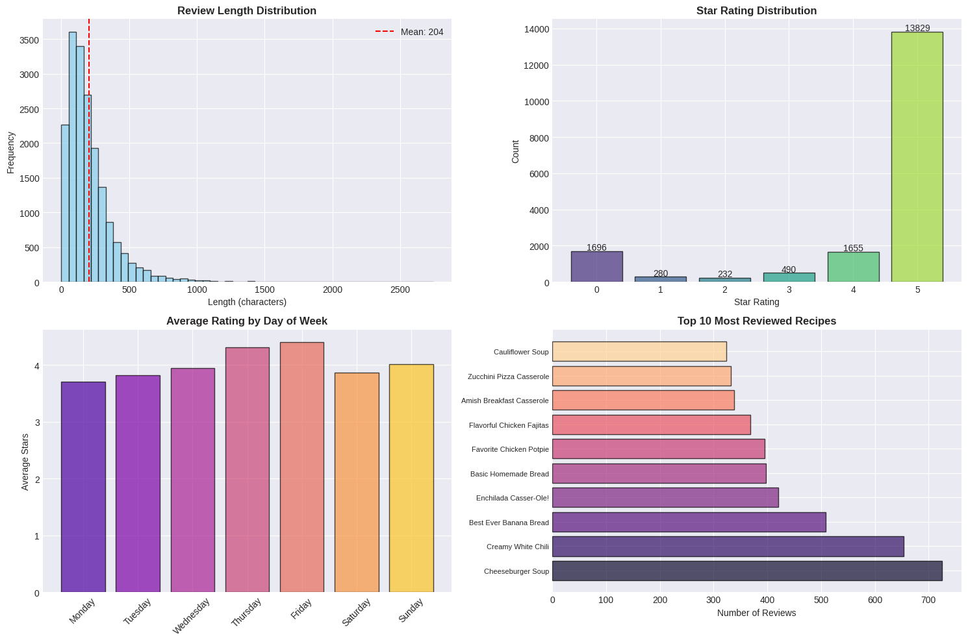
DATA PREPARATION & EXPLORATION

Slide 6
CLASS IMBALANCE ANALYSIS
CLASS IMBALANCE ⚠️
⭐ 5-star: ████████████████████████████ 77.1%
⭐ 4-star: ████░░░░░░░░░░░░░░░░░░░░░░░░ 10.8%
⭐ 3-star: ██░░░░░░░░░░░░░░░░░░░░░░░░░░ 5.7%
⭐ 2-star: █░░░░░░░░░░░░░░░░░░░░░░░░░░░ 3.4%
⭐ 1-star: █░░░░░░░░░░░░░░░░░░░░░░░░░░░ 3.0%
IMPACT:
❌ Models biased toward positive reviews
❌ Minority classes poorly predicted
✅ SMOTE needed for fair classification

Slide 7
NLP PREPROCESSING PIPELINE
📝 TEXT PROCESSING WORKFLOW
Raw Text → Tokenization → Lowercasing → Filter → Stopword Removal → Lemmatization → Processed Tokens
EXAMPLE
ORIGINAL:
"I tweaked it a little, removed onions because of onion haters in my house"
↓ PROCESSED ↓
['tweak', 'little', 'remove', 'onions', 'onion', 'haters', 'house', 'use', 'italian', 'season']
⚙️ VECTORIZATION METHODS
📊 CountVectorizer: Raw frequency counts
📈 TF-IDF: Term frequency-inverse document frequency
⚙️ Configuration: min_df=2, max_features=2000

Slide 8
VADER SENTIMENT ANALYSIS
📊 VADER Sentiment Distribution:
Positive ████████████████████████ 71.3%
Neutral ████████░░░░░░░░░░░░░░░░ 19.8%
Negative ████░░░░░░░░░░░░░░░░░░░░ 8.9%
📈 VADER Score vs Star Rating:
• Strong alignment with user ratings
• Higher scores for 4-5 star reviews
• Validates sentiment approach

Slide 9
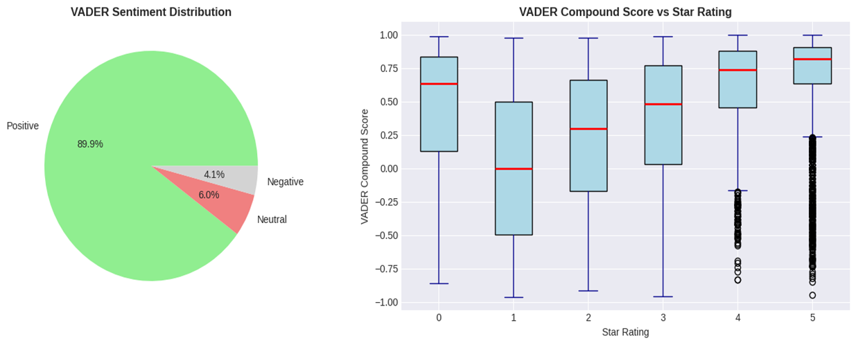
VADER SENTIMENT ANALYSIS

Slide 10
6-CLASS CLASSIFICATION RESULTS
TARGET: 1-5 Star Ratings (6 classes)
📊 PERFORMANCE:
⚠️ KEY INSIGHT
• Accuracy looks reasonable (~75%)
• BUT Macro F1 is very low (0.278-0.325)
• Minority classes (1-4 stars) are poorly predicted
• Class imbalance severely impacts performance
Model | Accuracy | Macro F1 | Wtd F1
Logistic + Count | 75.4% | 0.325 | 0.718
Logistic + TF-IDF | 77.5% | 0.278 | 0.709
Naive Bayes + Count | 72.1% | 0.325 | 0.707

Slide 11
SMOTE BALANCING
3-CLASS WITH SMOTE
🔄 LABEL MAPPING:
• 1-2 stars → Negative
• 3 stars → Neutral
• 4-5 stars → Positive
📊 SMOTE IMPACT:
✅ IMPROVEMENTS:
• 40-60% F1 increase for minority classes
• Fairer model performance
Class | Before | After
Positive | 14,145 | 14,145
Neutral | 912 | 14,145 ✅
Negative | 1,035 | 14,145 ✅

Slide 12
FINAL RESULTS
FINAL MODEL COMPARISON
📊 PERFORMANCE (with SMOTE):
📊 CLASS-WISE F1 SCORES:
🏆 BEST MODEL: Linear SVC + SMOTE
Model | Accuracy | Wtd F1
Logistic Regression | 75.8% | 0.758
Naive Bayes | 71.3% | 0.714
Linear SVC 🏆 | 75.4% | 0.777
Class | F1 Score
Negative | 0.70
Neutral | 0.37 ⚠️
Positive | 0.77

Slide 13
KEY INSIGHTS & IMPACT
💡 TOP FINDINGS:
1. CLASS IMBALANCE IS CRITICAL
• SMOTE improved minority F1 by 40-60%
2. MODEL SELECTION MATTERS
• Linear SVC achieved best performance
• 75.4% accuracy, 0.777 weighted F1
3. NEUTRAL CLASS IS CHALLENGING
• Lowest F1 (0.37) due to ambiguous reviews
🏢 BUSINESS APPLICATIONS:
• Identify dissatisfied users for service
• Promote highly-rated recipes
• Detect negative sentiment trends
• Improve recommendation systems

Slide 14
CHALLENGES & FUTURE WORK
⚠️ CHALLENGES:
• Severe class imbalance (77% 5-star)
• Short, informal reviews (avg 204 chars)
• Neutral class difficult to classify
🔮 FUTURE WORK:
• Transformer models (BERT, DistilBERT)
• Alternative balancing techniques
• Recommendation systems using embeddings
• Aspect-based sentiment analysis

Slide 15
CONCLUSION 🎯
✅ ACHIEVEMENTS:
• Built complete end-to-end NLP pipeline
• Processed 18,000+ recipe reviews
• Compared multiple ML models
• Addressed class imbalance with SMOTE
• Achieved 75%+ accuracy & 0.777 weighted F1
📊 BEST MODEL: Linear SVC + SMOTE
💡 KEY TAKEAWAY:
Classical ML remains effective when handling
class imbalance properly. SMOTE significantly
improves minority class performance.
🔮 NEXT STEPS:
Explore deep learning & transformer models for further improvement.

Slide 16
REFERENCES
📚 DATASET:
UCI Machine Learning Repository - Recipe Reviews
📖 COURSES:
• NLP with Classification (Coursera)
• ML for Beginners (Microsoft)
📄 DOCUMENTATION:
• NLTK • Scikit-Learn
📕 BOOKS:
NLP with Python (Bird, Klein & Loper)
👨‍🏫 MENTORSHIP:
Dr. Raji Ghawi - ReDI Connect

Slide 17
THANK YOU

